Slide 1



Group Members: Pallavi Chauhan + Kim Duong +Karthik Venkatesh
ISQA 8086: Data Analysis Project

Slide 2
Overview
Research Question
Data Origin
Data Usage
Data Limitations
Data Interpretation
Analysis Decision

Slide 3
Research Question
Which Site at Linda Loring Foundation has the phenophase activity breaking of leaf Bud occur first for the plant Beach Plum?
How does minimum temperature at each site affect the Phenophase activity Breaking of Bud in Beach Plum?

Slide 4
Data Origin
Temperature Data
Origin: Shared directly from Linda Loring Nature
Timeline: December 2014 through May 2018
Linda Loring Nature Found Phenology Data Set
Origin: Phenology Observation Portal
Fields Important for Research Question:
Intensity_Value ,Common_Name, Date of Observation, Day_of _Year, Phenophase_Name , Phenophase_Status, Site Name

Slide 5
Data Usage
Data Preparation
Clean data using Excel and RStudio
Data Analysis
Compare intensity values throughout different sites include years
Observe phenophase status trend throughout different sites include years
Observe the minimum temperature at each site for different years.
Data Visualization
Visual Plots

Slide 6
Data Limitations
Temperature Data Set
The temperature data set provided to us missed the temperature recordings for different sites.
In some case the temperature recording available for site was after October, While we needed the temperature data during the spring time of April – May for Beachplum to analyze the Phenophase activity of Breaking of Buds.

Slide 7
Data Interpretation
The important information that we could intrepret from the plots is that the Beachplum breaks bud first at site G over all the years 2016,2017,2018 indicating that site G needs investigation.
From the Temperature plots we could analyze that the breaking leaf bud activity occurs when the minimum temperature was around 10 deg Celsius and above.

Slide 8
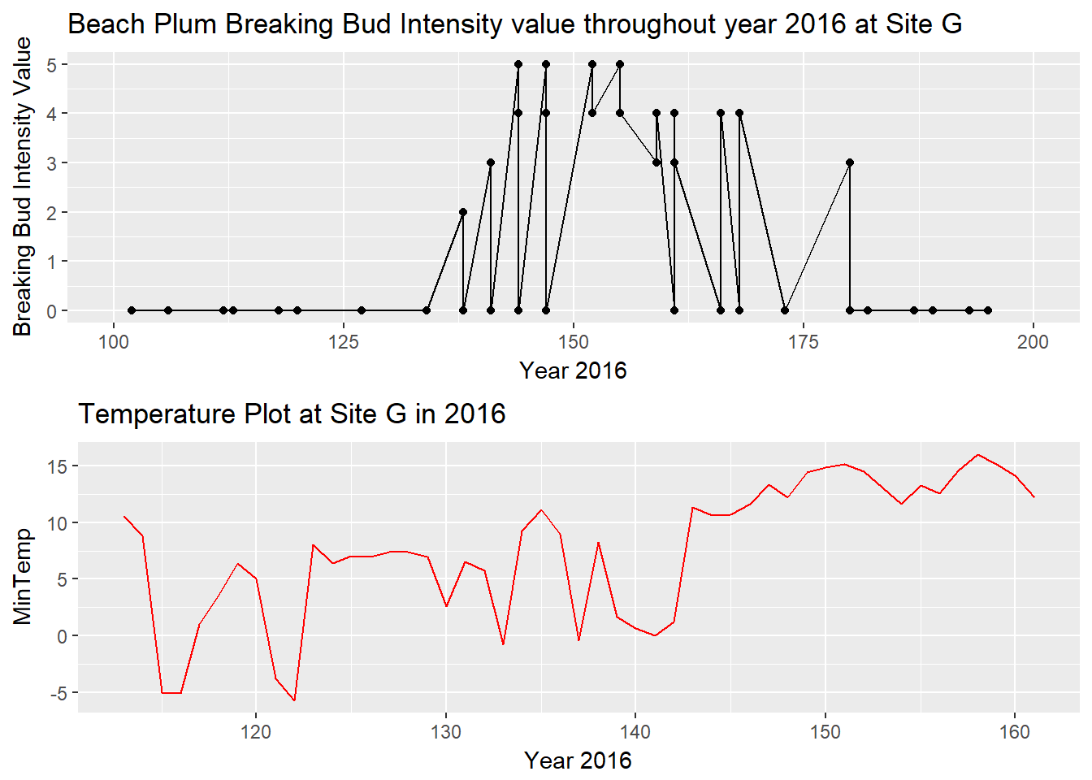
Data Interpretation

Slide 9
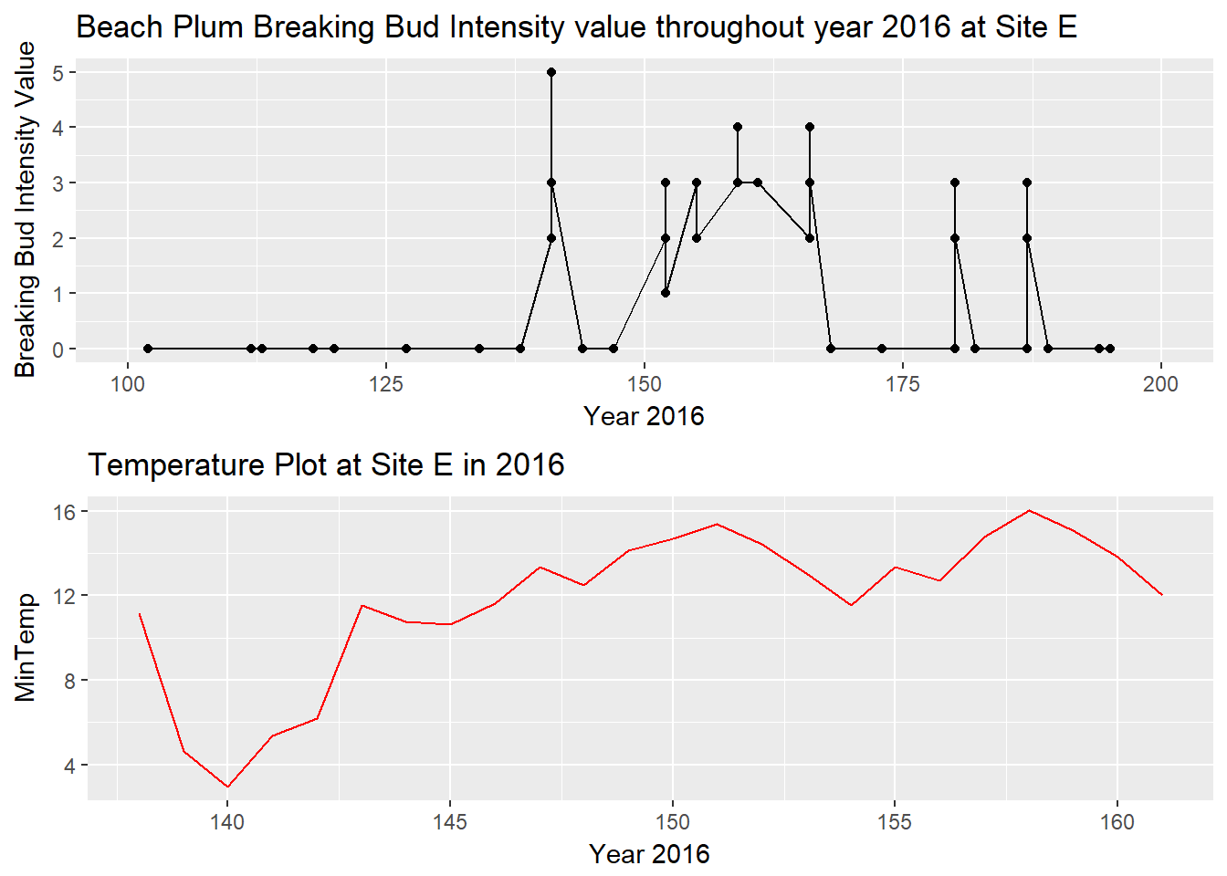
Data Interpretation

Slide 10
Analysis Decision
Site G must be investigated to determine, why the Breaking leaf bud’s Phenophase activity occurs first for Beach Plum when compared to other sites for the species.

